Slide 1
Jupyter Notebooks
KROLL BOND RATING AGENCY, INC

Slide 2
Agenda
Pete
Introduction
CMBS
Predictive Modelling
Text Mining
Traditional Regression
Words
Natural Language Processing
CNN
GPU
Jupyter Notebook
Paperspace Gradient
Colab

Slide 3
Cheat sheet
Green Cell – ready to edit code
Enter – new line
Shift + Enter – execute and move
Ctrl + Enter – execute and stay
Escape – leave edit cell mode
Blue Cell –ready to edit notebook
<enter> - switch to editing cell
A - add cell above
B – add cell below
M – make cell Markdown
X – remove cell

Slide 4
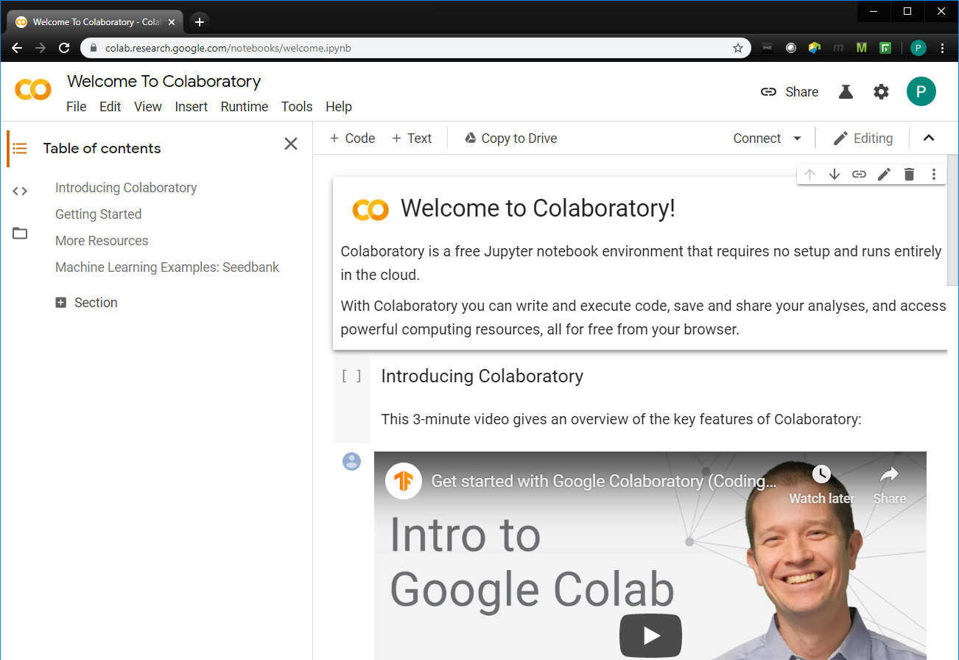
Colab
https://colab.research.google.com/notebooks/welcome.ipynb

Slide 5
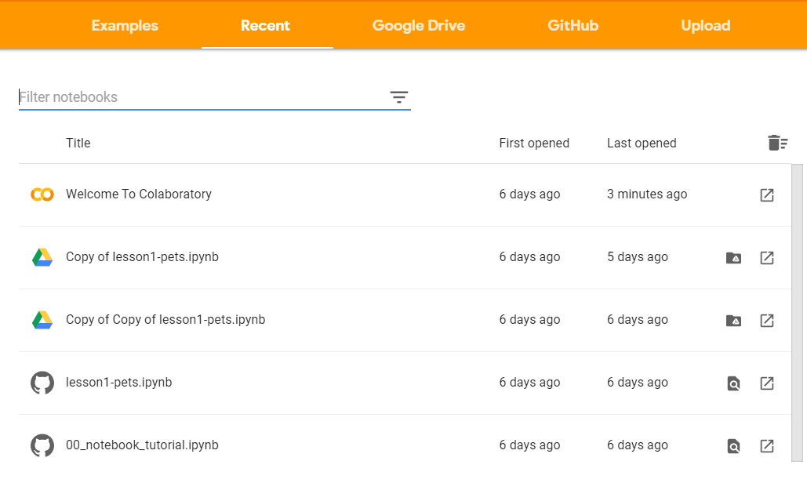
Colab
File – Open notebook… (Ctrl+O) in Welcome To Colaboratory presents

Slide 6
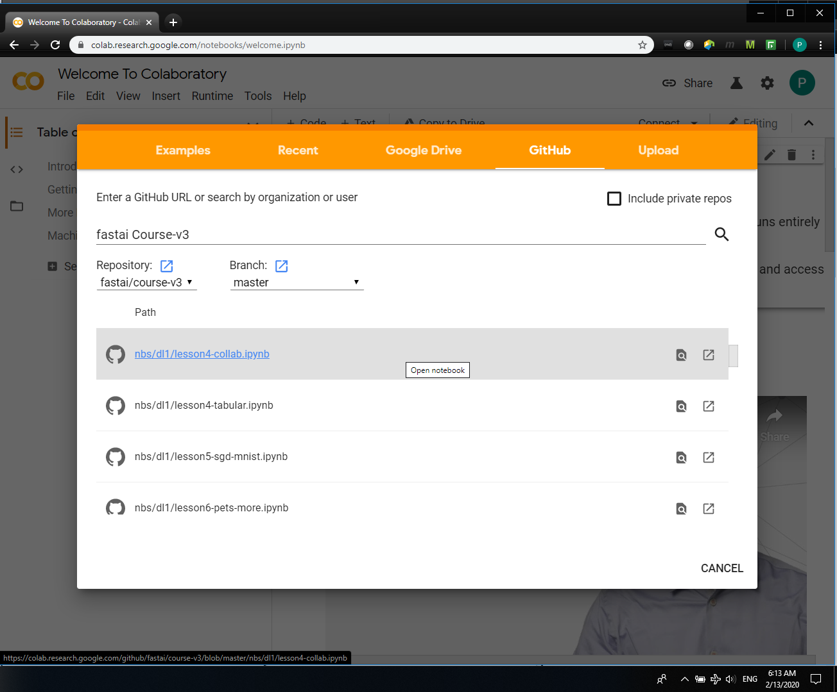
Colab
Click GitHub and search for the version 3 of the fast ai course

Slide 7
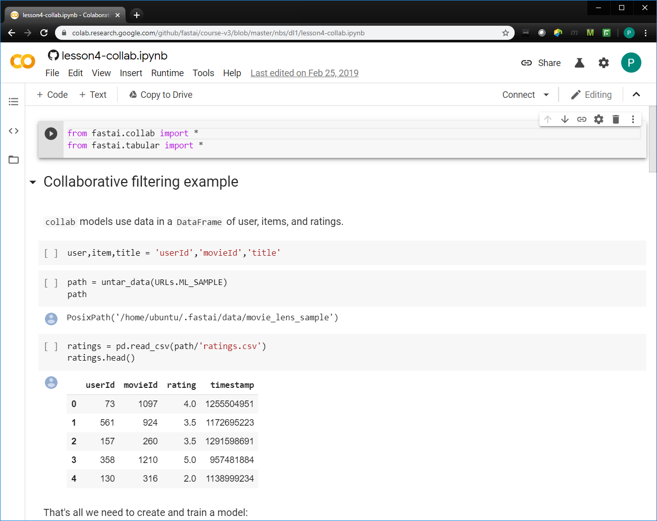
Colab
File – Save copy in drive

Slide 8
Colab
Click GitHub and search for the version 3 of the fast ai course

Slide 9
Colab
Click GitHub and search for the version 3 of the fast ai course

Slide 10
Colab
Click GitHub and search for the version 3 of the fast ai course

Slide 11
Colab
Click GitHub and search for the version 3 of the fast ai course

